Slide 1
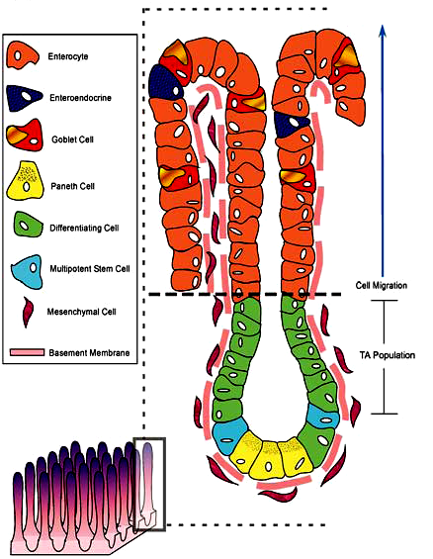
Villus
Intestinal gland

